Slide 1
GRADUATE Professional Development Week 1

Slide 2

Course Structure
A weekly 1 hour lecture
A weekly 2 hour seminar
2 assessments each worth 50%

Slide 3
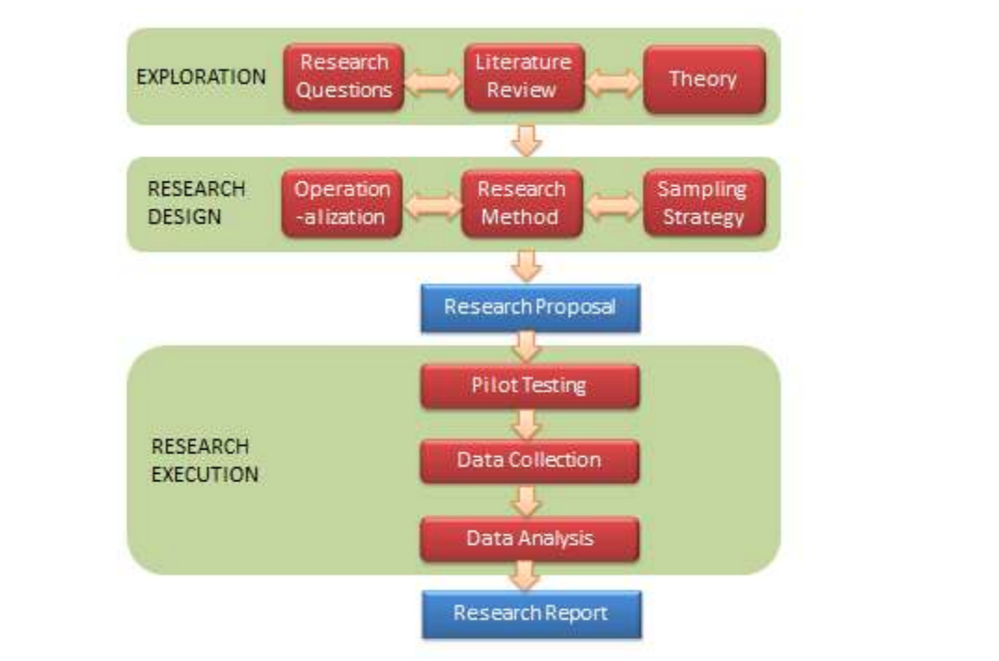
Assessment 1 (Reflective Report)
(Due: 15th Nov, 2019 )
Research on small group development
Exploration
t
The the formation of your own group
Observe
The performance of your group
Evaluate

Slide 4
Assessment 2 (Project Proposal)
Due: 10th Jan, 2020
Problem Statement
Hypothesis/ Research Question
Literature Review
Exploration
t
Research Methods
Research Schedule
Specification
Assessment 2 – Project Proposal

Slide 5
Final Year
Implement artifact
Design data collection methods
Implementation
Collect Data
Answer Research Question/Hypothesis
Evaluation
Final Year Project

Slide 6
What is science (what leads to the truth)?

Slide 7
What does it mean to be a graduate ?

Slide 8
"Graduates are thought to feel a need to seek and evaluate evidence before coming to a conclusion, not to accept ‘spin’ as readily as non-graduates, to question the status quo, to show intellectual curiosity about the social world" (Biggs 2011, p.111)

Slide 9
(Biggs, 1999)

Slide 10
Assessment 1 Introduction

Slide 11
Key Readings
- TUCKMAN, B. 1965. Developmental sequence in small groups. Psychological Bulletin, 63(6), 384–399
- TUCKMAN, B. AND A. JENSON,1977. Stages of Small-Group Development Revisited. Group & Organization Studies, 2(4),419-427

Slide 12
To help us reflect on our groups performance, we are going to use Tuckman's (1965) model of 'DEVELOPMENTAL SEQUENCE IN SMALL GROUP’
Tuckman 1965 reviewed 50 studies around group formation
Tuckman catorgarises these studies into Training, Therapeutic, Natural and Laboratory group settings
After analysing the literature he came up with the following group formation stages norming, forming, storming, performing and adjourning

